Slide 1
Compilation Techniques (12)
Optimizations
Unreachable code elimination
Constant folding/propagation
Common subexpression elimination
Strength reduction
Functions inlining
© Codruta-Mihaela ISTIN 2015

Slide 2
Optimizations (1)
In many cases the code generated on the code generation phase can be optimized by some methods:
  precompute the constant expressions so they can be directly replaced with their result
  reuse the memory locations in order to decrease memory usage
  replace instructions sequences with faster or shorter equivalents
  reorder the code to reduce the need for some instructions or to favor specific (most common) alternatives
  delete unreachable code
To a great extent, these methods can be applied automatically and the programmer can obtain “for free” a speedup and/or memory footprint reduction
By knowing how a compiler generates and optimizes the code, a programmer can also help it by using specific programming patterns
© Codruta-Mihaela ISTIN 2015

Slide 3
Optimizations (2)
For effective optimizations, the instruction set is best to have some characteristics:
  orthogonal – there must be instructions for all allowed operations in order not to use casts or other means to accomplish a single operation (ex: JVM does not have multiply instructions for all its numeric types => not orthogonal)
  an instruction should have in itself all its operands – this means that stack based VM are poor candidates for powerful optimizations, because in many cases an instruction cannot be moved or replaced without needing to replace a hole sequence of operations
  should provide a small but comprehensive set of operations – some µP have a dedicated “INC” instruction, beside “ADD”. From an optimization point of view, this only adds another case to be taken care of
Many optimizing compilers optimize the code using an intermediate representation which respects the above characteristics and only after that they generate the final code
Each optimization type is a “pass”. An optimizer can make multiple passes. If some passes produce optimizations, this process can be repeated because new opportunities may arise from the former passes
© Codruta-Mihaela ISTIN 2015

Slide 4
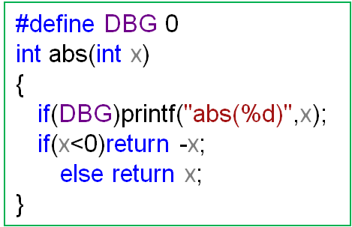
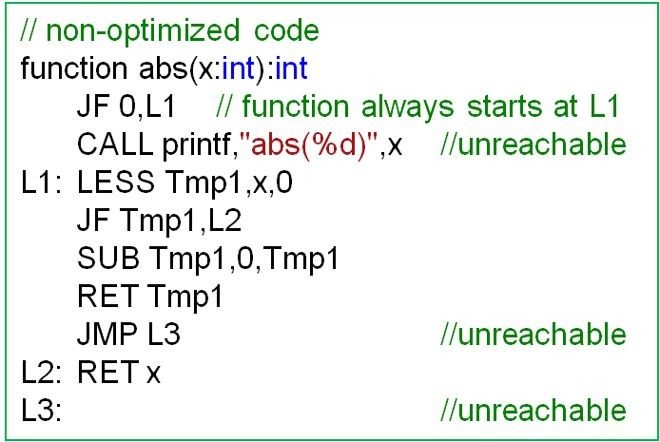
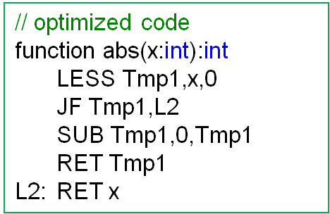
Unreachable code elimination
Algorithm: for each function (code entry point) all the possible paths are traced. The instructions which cannot be reached through any path are considered unreachable and they are deleted.
The traces can take into account different conditions, such as the fact that a constant false “if” condition eliminates the execution of that “if” statement
Other cases of useless code: JMP to JMP → JMP; NOP → nothing
© Codruta-Mihaela ISTIN 2015

Slide 5
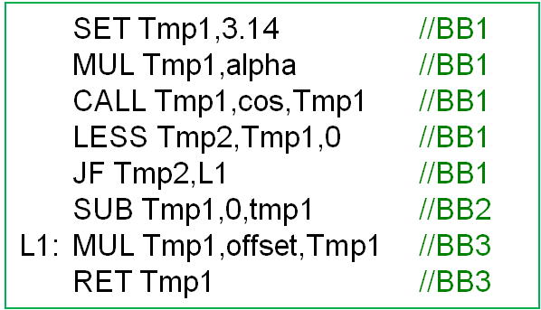
Basic blocks
A sequence of instructions with a single entry point at its beginning and a single exit point at its ending
A basic block (BB) can be entered from multiple other BB and it can branch to multiple other BB (ex: when the last instruction is a JT there will be two exit BB)
Inside a BB many optimizations are possible because the instructions order is unique and every instruction is executed exactly once
A function which returns is inside a BB; a function which does not return (ex: it calls “exit” or throws an uncaught exception) is at the end of the BB
The BBs are the nodes of a graph with transitions made by the possible transitions between blocks: control flow graph
© Codruta-Mihaela ISTIN 2015

Slide 6
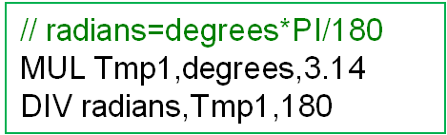
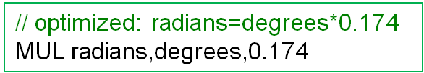
Constant folding/propagation
Algorithm: the operations with known results are evaluated to their results. In its basic form, this evaluation takes place only in a BB
Examples: 1*x → x, “Sun”+”rise” → ”Sunrise”, “pi=“+PI → ”pi=3.14”
Because expressions can be reduced to constants, this optimization allows other optimizations such as unreachable code elimination
© Codruta-Mihaela ISTIN 2015

Slide 7
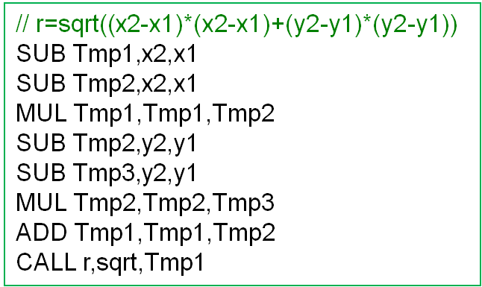
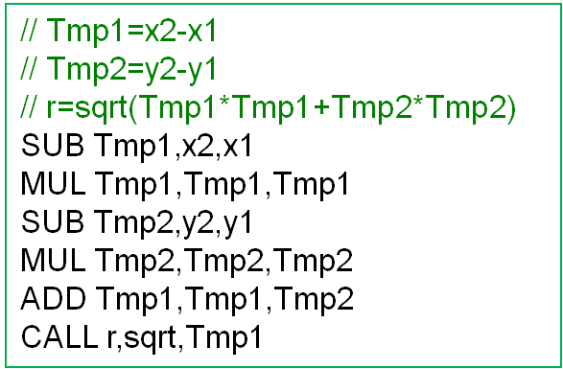
Common subexpressions elimination
Algorithm: common subexpressions that appear inside one or more expressions are computed only once. This optimization can be done only if the subexpressions operands do not change between subexpressions.
A change in operands values can appear indirectly, for example by calling a function which has a side effect of modifying one operand value
© Codruta-Mihaela ISTIN 2015

Slide 8
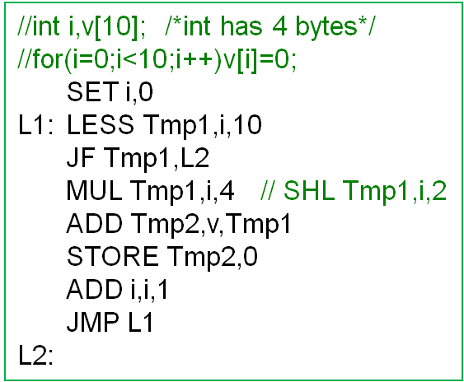
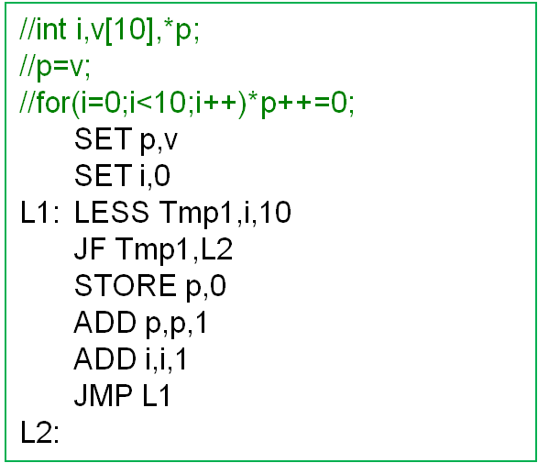
Strength reduction
In some cases complex operations can be substituted with simpler ones:
  integer multiplication by powers of 2 with bits shift left: k*8 == k<<3
  integer division by powers of 2 with bits shift right: k/256 == k>>8
Especially inside loops, array addressing can be substituted with direct pointer access. In some cases a pointer can eliminate the need of index
For loops, constant expressions can be precomputed only once, before loop
© Codruta-Mihaela ISTIN 2015

Slide 9
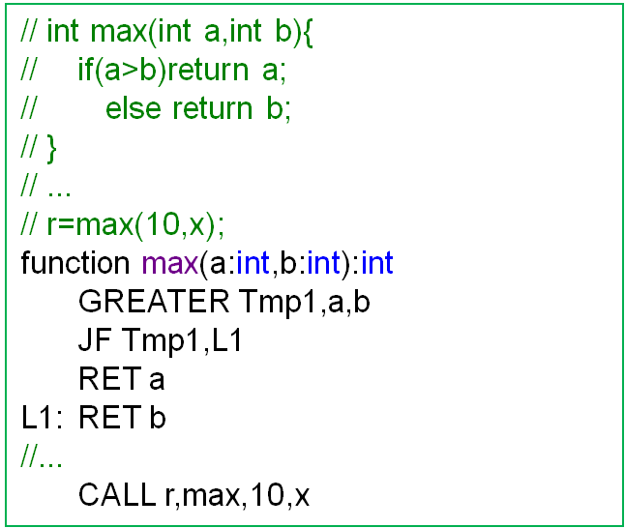
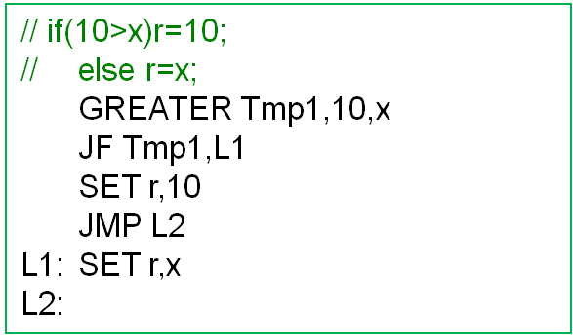
Functions inlining
Especially in OOP programming are many small functions (ex: constructors), which only sets some few values
In these cases the overhead incurred by setting up the activation frame and call instructions (PUSH arguments -> CALL -> ENTER -> RET) can be much higher than the few instructions executed in that function
It is much better to inline the function at the call place, so there will be no call overhead
© Codruta-Mihaela ISTIN 2015

Slide 10
Bibliography reading
Compilers. Principles, Techniques and Tools
9.1, 9.2, 9.5, 9.6
© Codruta-Mihaela ISTIN 2015

